Slide 1



Growing with Digital Marketing

Slide 2

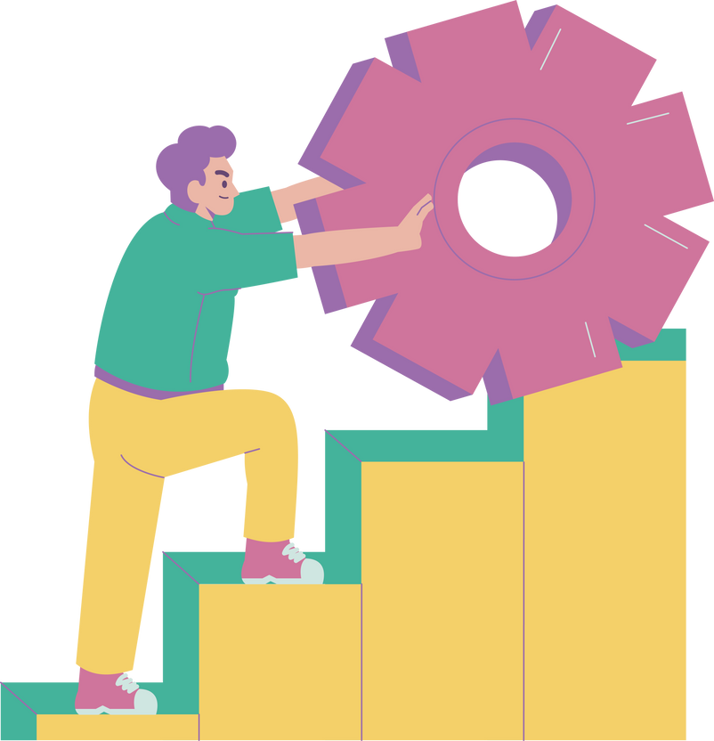
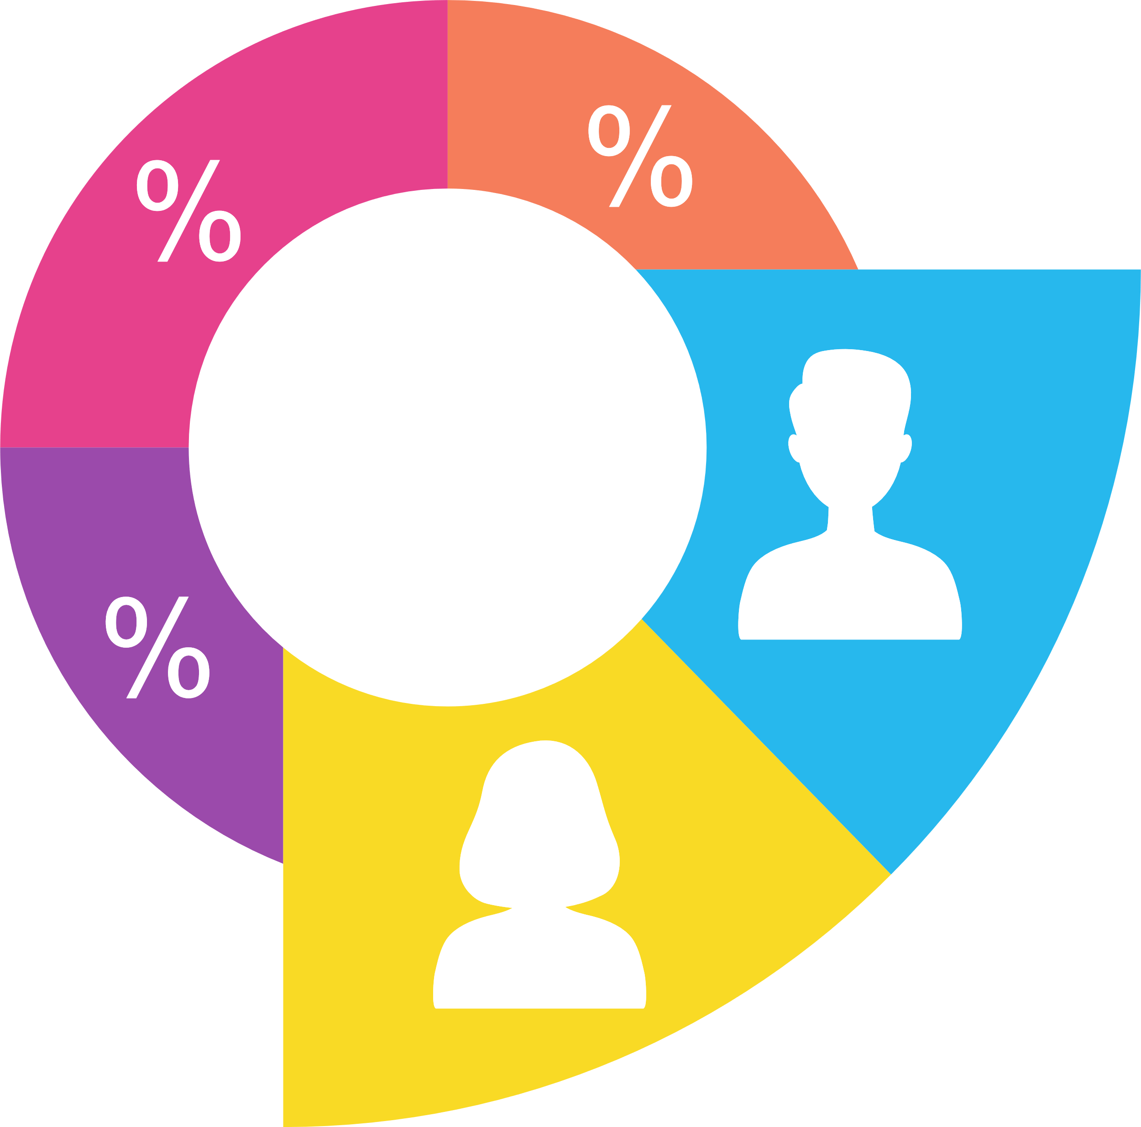



Digital Trends in India 2024
Challenges & Opportunities
Digital Landscape
  Internet Users: 751.5M (52.4% penetration).
  Social Media Users: 462.0M (32.2% of pop).
  47.6% offline population; scope for digital inclusion.
  Booming market for digital marketing
Demographics
Popular Platforms
  Facebook, YouTube, Instagram, Snapchat, LinkedIn.Internet usage peaks among 25-34 age group
  Median Age: 28.4 years.
  Internet usage peaks among 25-34 age group
* DataReportal's Digital 2024 report on India.

Slide 3
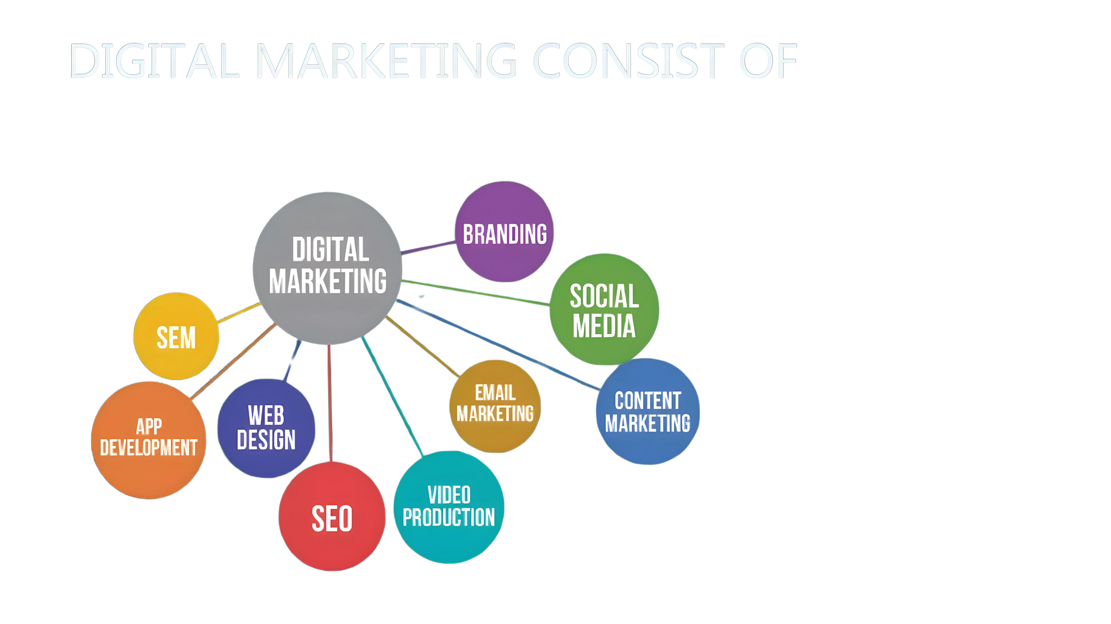
DEFINITION
Digital marketing encompasses promoting products or services through online platforms and digital mediums like the internet, mobile devices, and display advertising.
BENEFITS OF DIGITAL MARKETING
DIGITAL MARKETING CONSIST OF
Time & Effort Saving
Economical
DIGITAL MARKETING
Flexibility
Impactful
Real Time Analysis
Instant Feedback

Slide 4
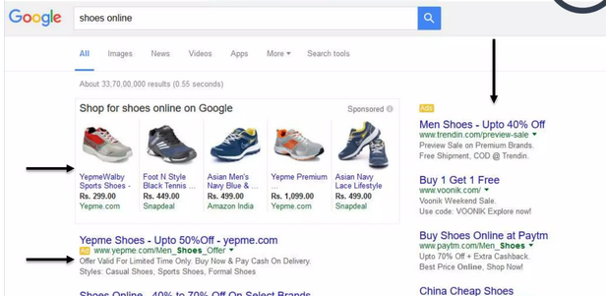
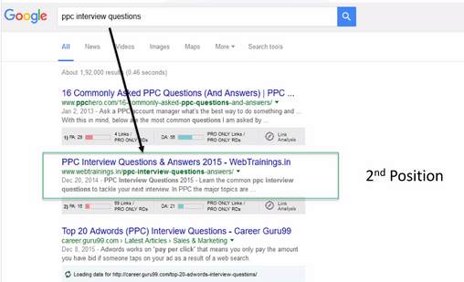
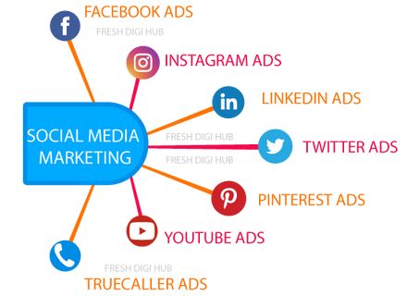
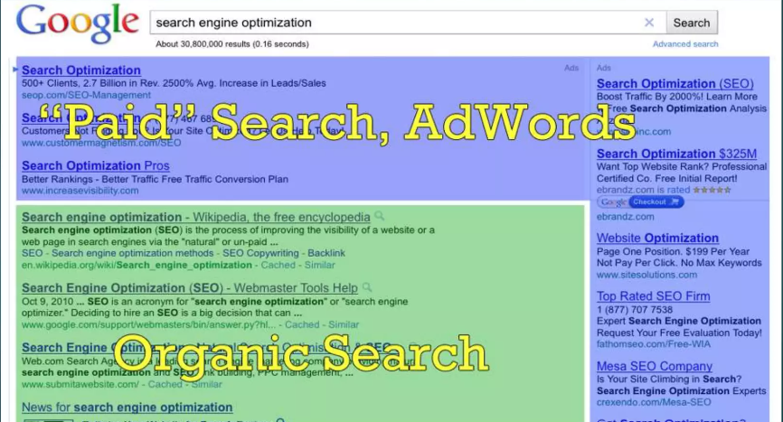
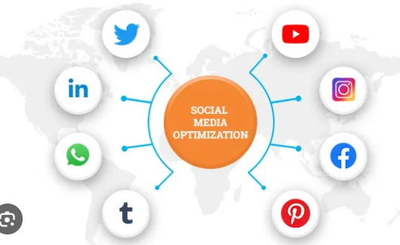
DIGITAL MARKETING AREAS
SEM (Search Engine Marketing)
SEO (Search Engine Optimization)
SMM (Social Media Marketing)
SMO (Social Media Optimization)

Slide 5
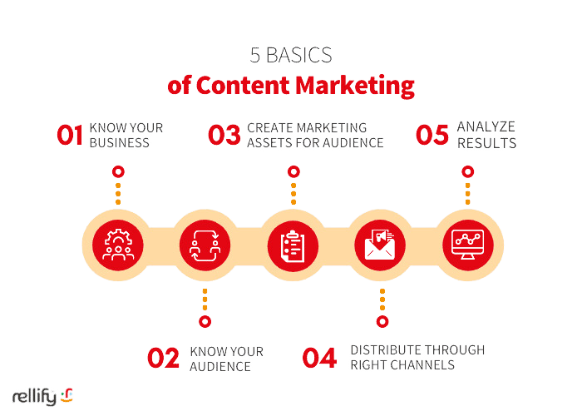
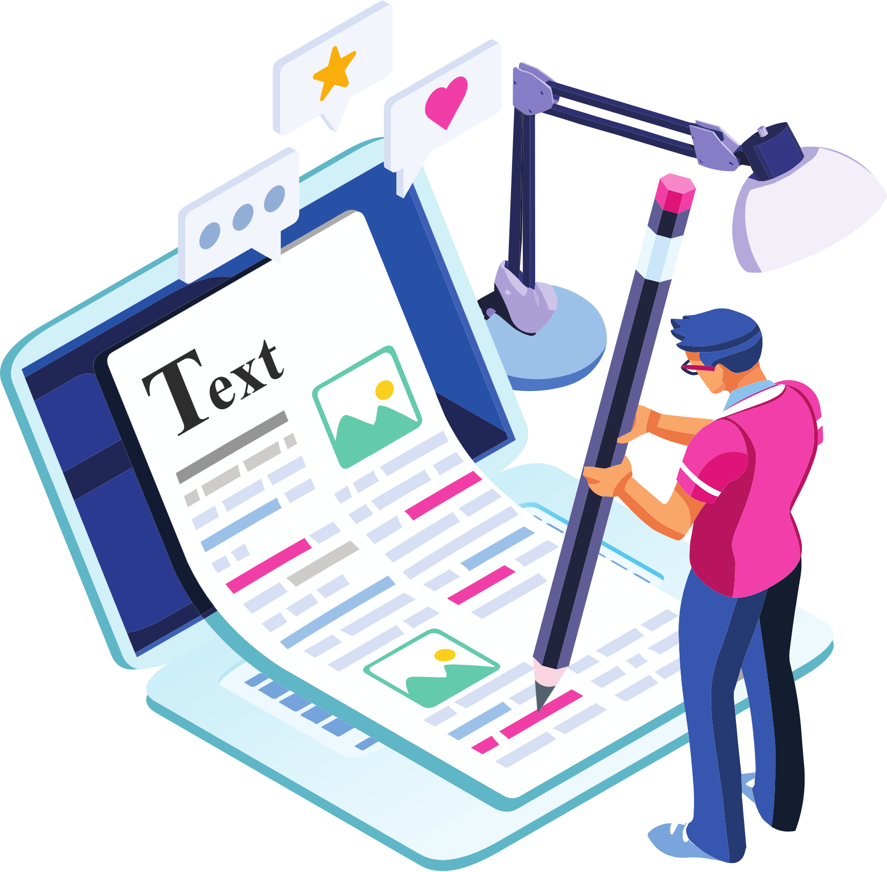
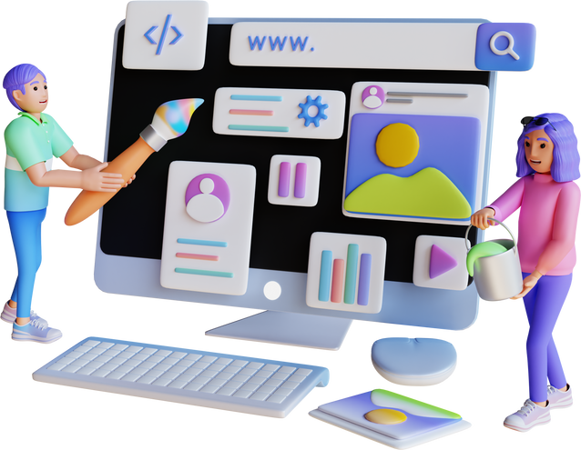

CONTENT MARKETING
Types of Content
Textual Content: Blogs, articles
Visual Content: Infographics, images, and videos
Interactive Content: Quizzes, polls

Slide 6
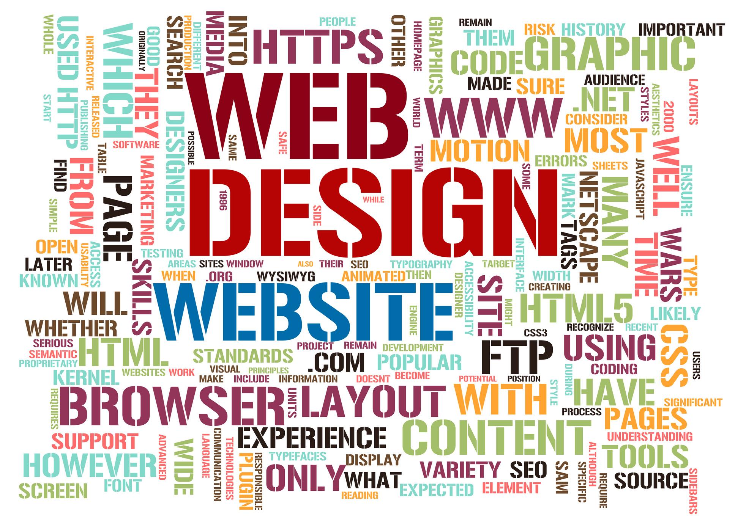
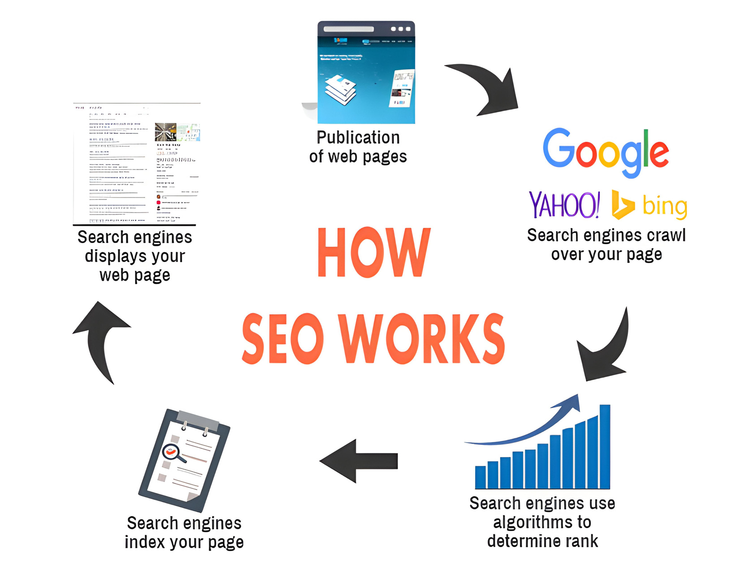
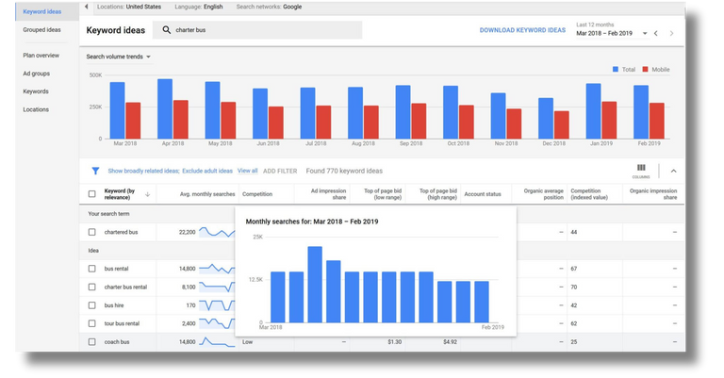
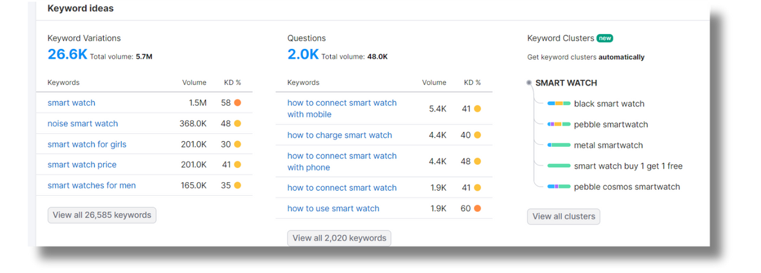
What is SEO ?
SEO (Search Engine Optimization) is the process of optimizing your website to rank higher in search engine results, increasing visibility and organic traffic.
SEO Strategies for Improved Content Discoverability
  Smart Keyword Usage
For finding the best keywords, we utilize various tools such as
-Google Keyword Planner, SEMrush, Ahrefs, Moz Keyword Explorer

Slide 7
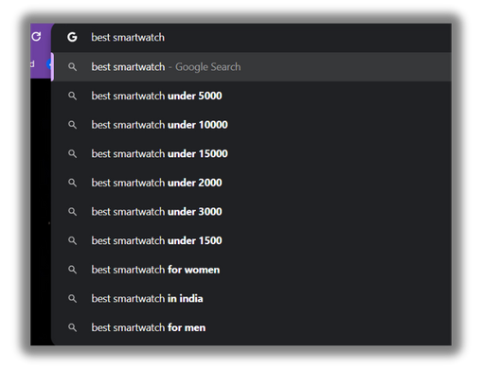
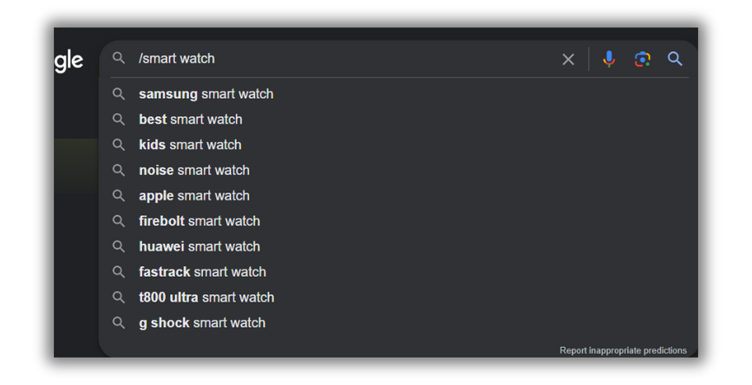
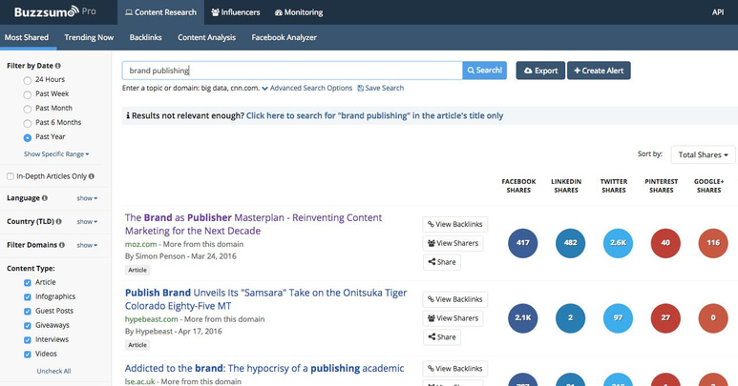
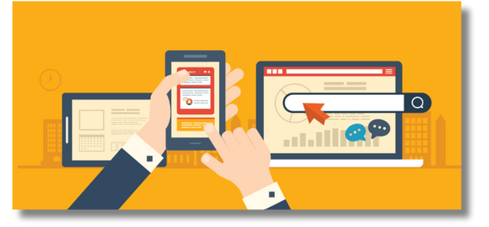
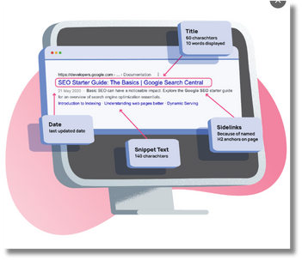
Search Engine Insights for Keywords
Identify Viral Posts using Buzzsumo
  Device Optimization
Optimizing for devices enhances SEO by improving user experience
  Not all tags that work for others will work for us. Regularly analyzing our stats is key.
  Optimized Titles and Meta Descriptions
Optimized tags, titles, and descriptions with keywords improve SEO and click-through rates.
  High-Quality Content

Slide 8
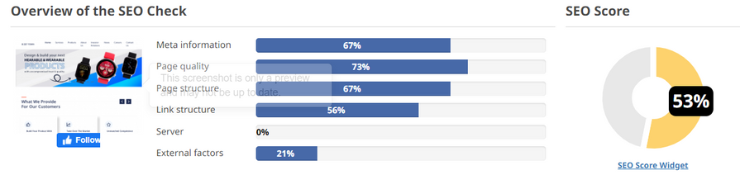
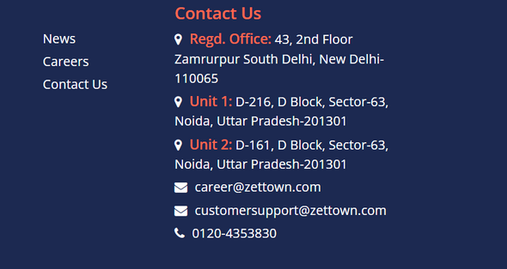
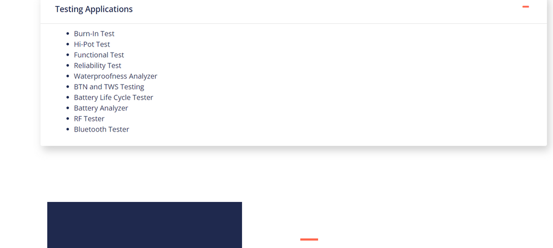
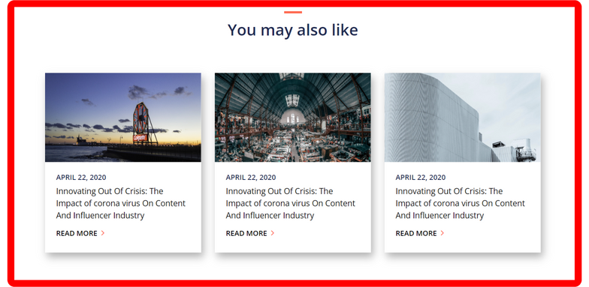
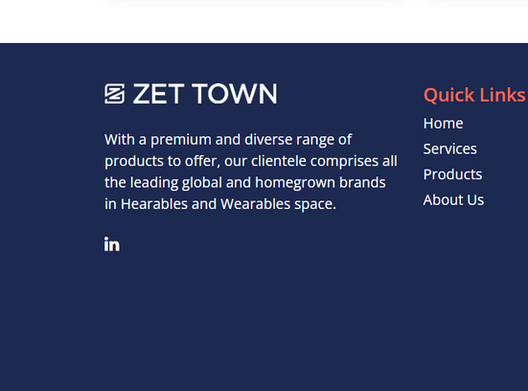

Current Status & Digital Presence
Current Website Analysis
Part I: Identifying Our Weaknesses
  Poor SEO Strategy
SEO Scores: Simplifying the Scale
  Above 80: Excellent
  60 to 80: Good/Average
  40 to 60: Below Average
  Below 40: Poor
Our website currently holds a SEO score of 53,%
  Lack of Updates
Content hasn't been refreshed in two years
Outdated info damages our credibility and relevance.
  Mistakes and Glitches
Template Stagnation
Hyperlink Dysfunctionality

Slide 9

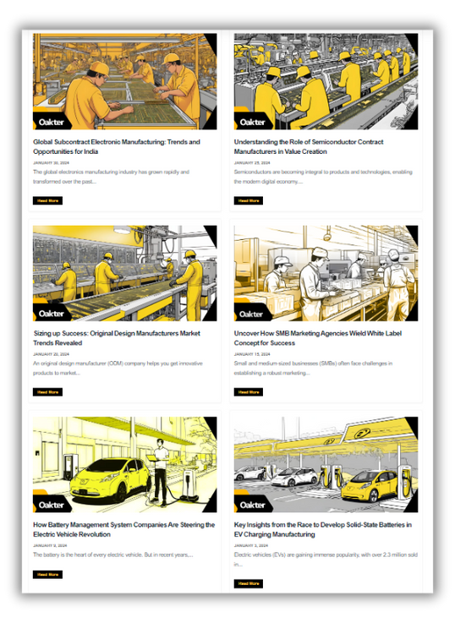
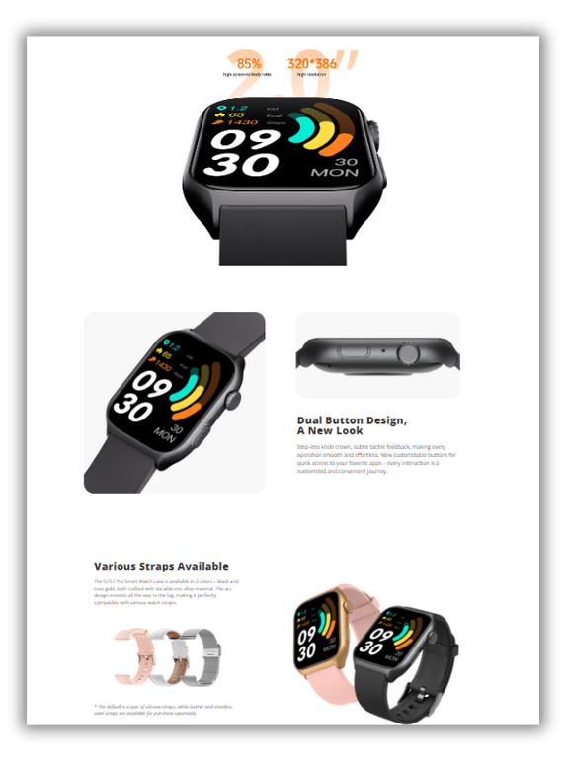
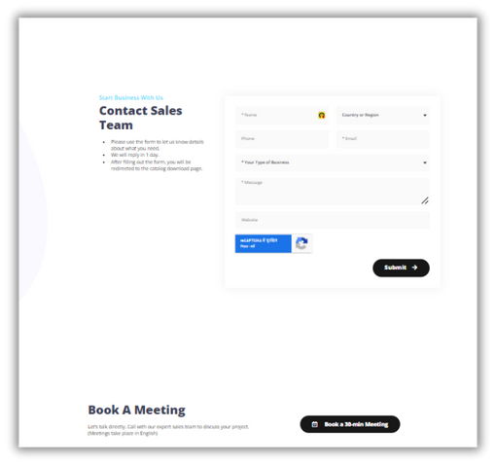
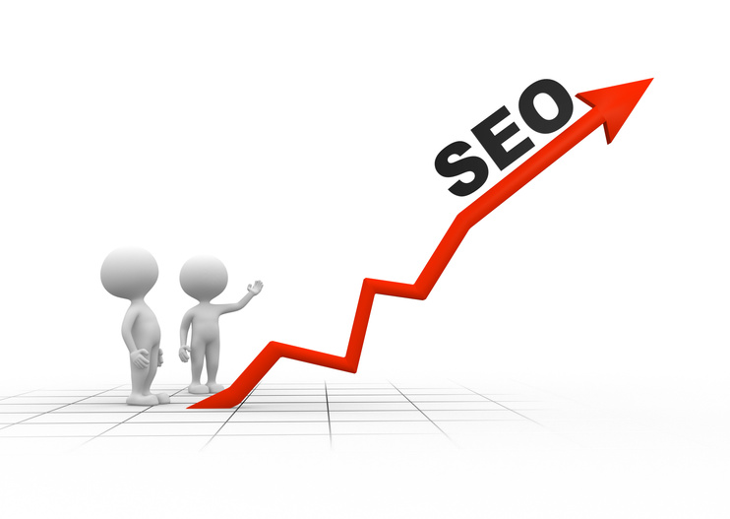
Part II: Strategies for Website Enhancement
Content Diversification
Add blog & news Page.
Include articles to solve customer problems.
Product Pages Optimization:
Detailed product pages for clarity.
Highlight features, specs, benefits.
Seamless inquiry forms for leads.
SEO Revamp
Optimize content, tags, headers for visibility.
Research keywords for relevance.

Slide 10

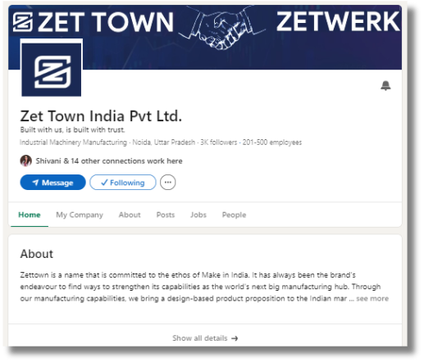
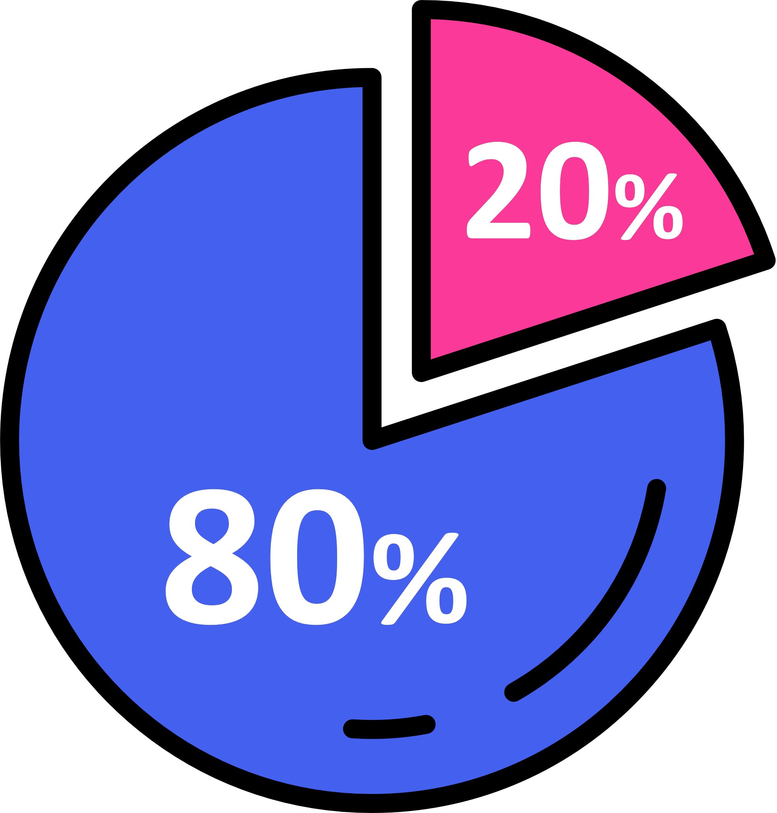
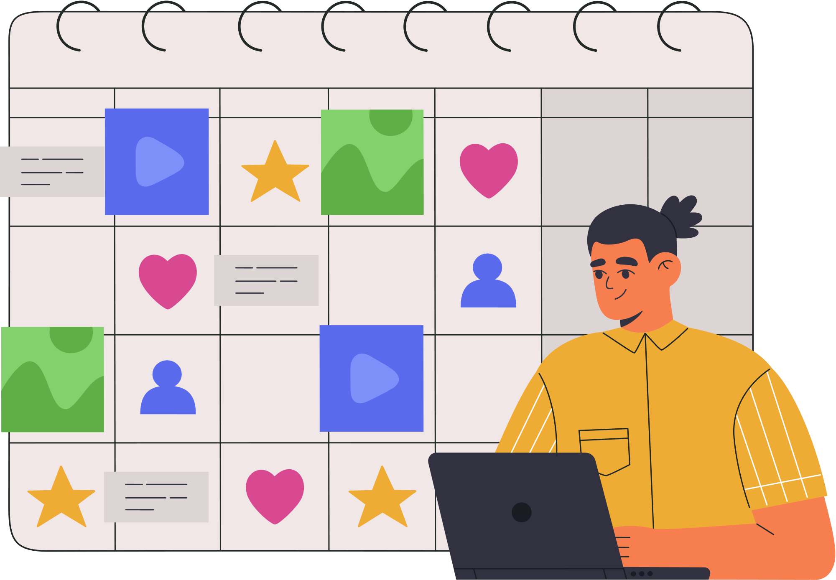


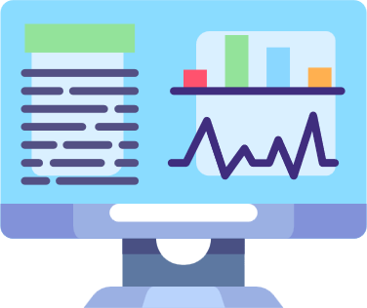

Current Linkedin Analysis
  No posts published yet.
  Data not updated.
How improve our LinkedIn presence
  The 80-20 Rule ( 80% engaging with others' content, 20% sharing our own for growth )
  Post, Post, Post !
  Keep company data updated
  Monitor analytics for adjustments
  Consider LinkedIn ads

Slide 11

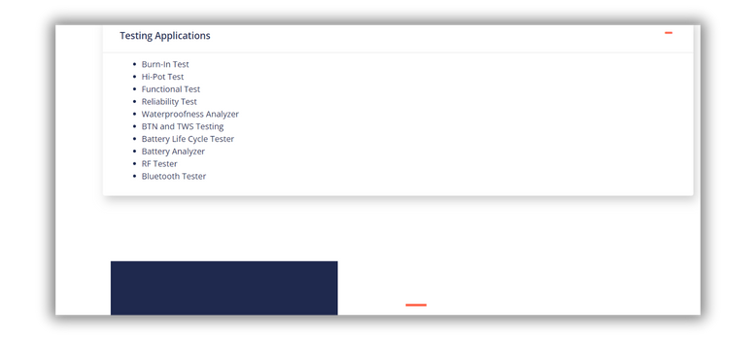
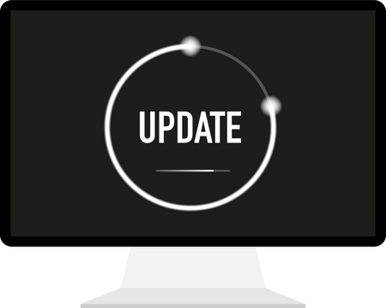
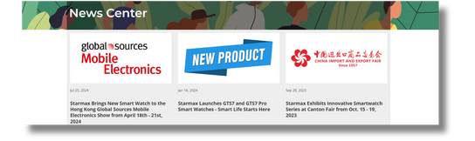
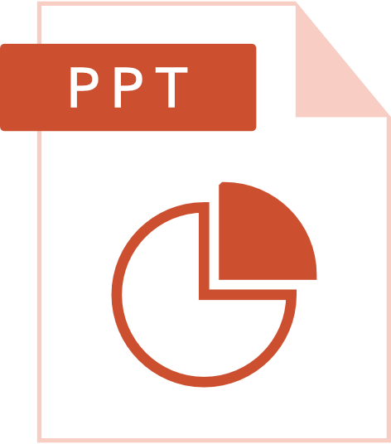
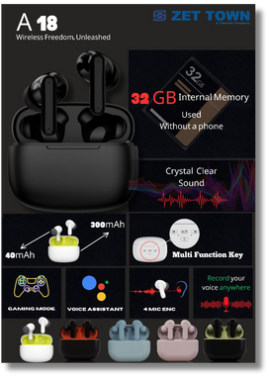
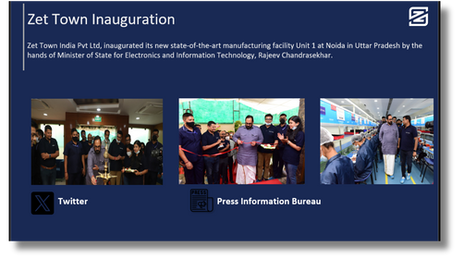
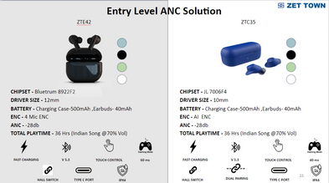

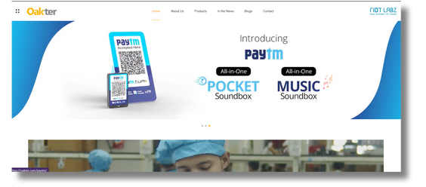
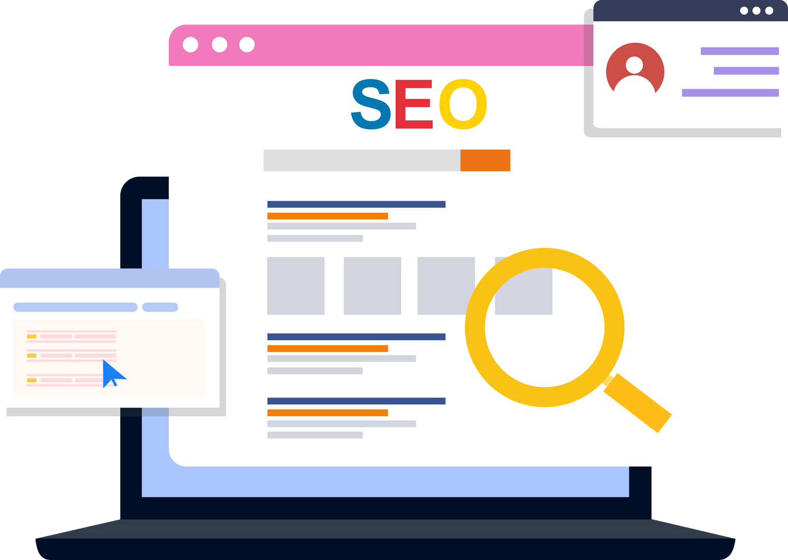
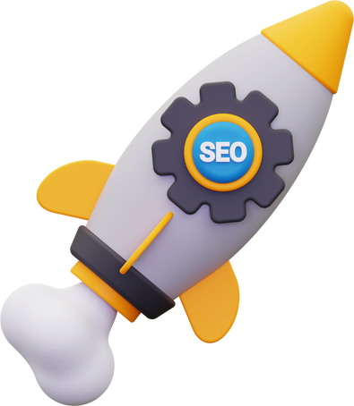
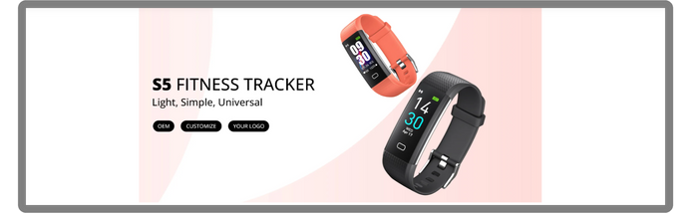
Our Next Content Creation Plan
Frequency and Formats
Data Updates Across Platform
3 blogs, 2 articles weekly.
Ensure data accuracy and relevance across platforms.
New Offerings and Updates
Corporate Presentations
Flexible uploads for new offerings, achievements, and events.
Upload corporate presentations and offerings PPTs.
Website Banners and Updates
SEO Optimization
Regular updates for website banners.
Regular changes for improved SEO.

Slide 12
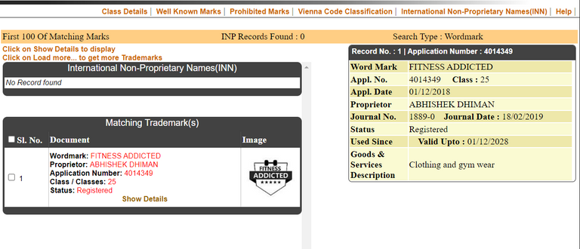
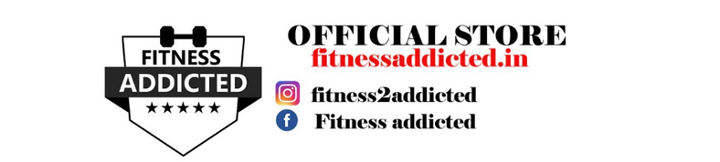
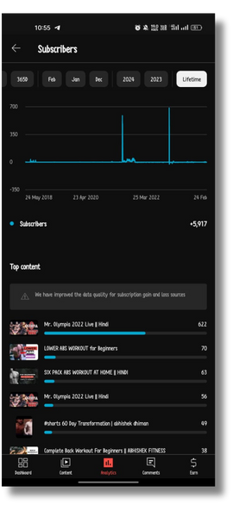
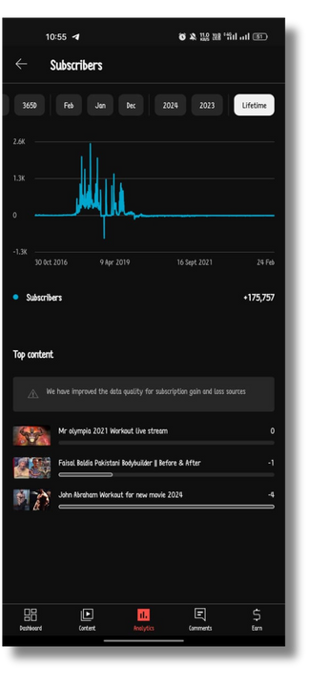
Personal Background
  Founded multiple startups with a focus on e-commerce and online branding.
  Successfully generated leads through content creation on websites and other platforms.
  Managed YouTube channels with 170K and 5K subscribers, providing insights into social media algorithms and strategies."

